Slide 1
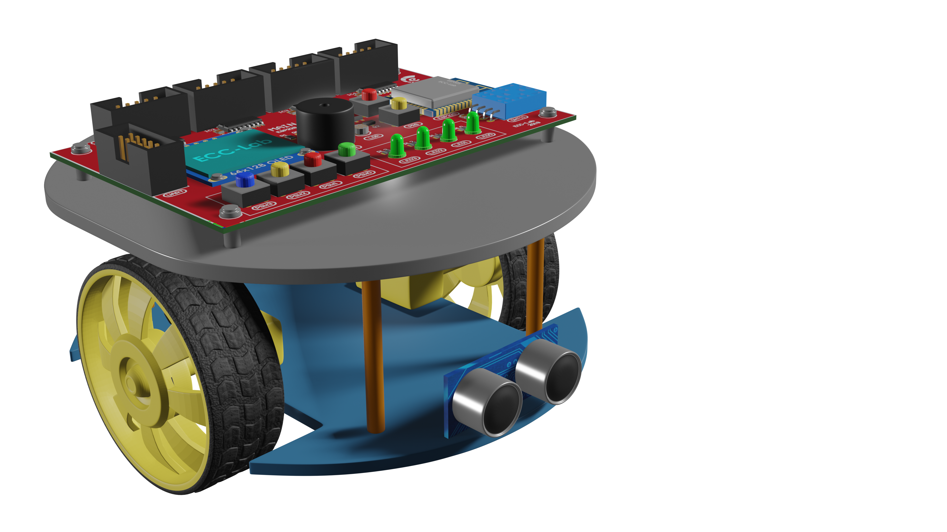
Robot Control Learning Platform
for Automation Engineers
01
Overview
02
Robot Microcontroller Design
03
Laboratory
Notes:
These are the contents that we are going to talk today

Slide 2
01
Overview
Notes:
Let’s start with the overview

Slide 3
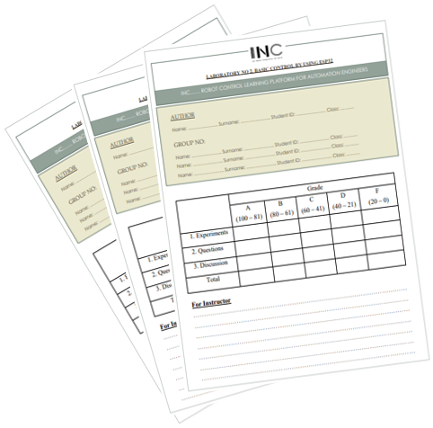
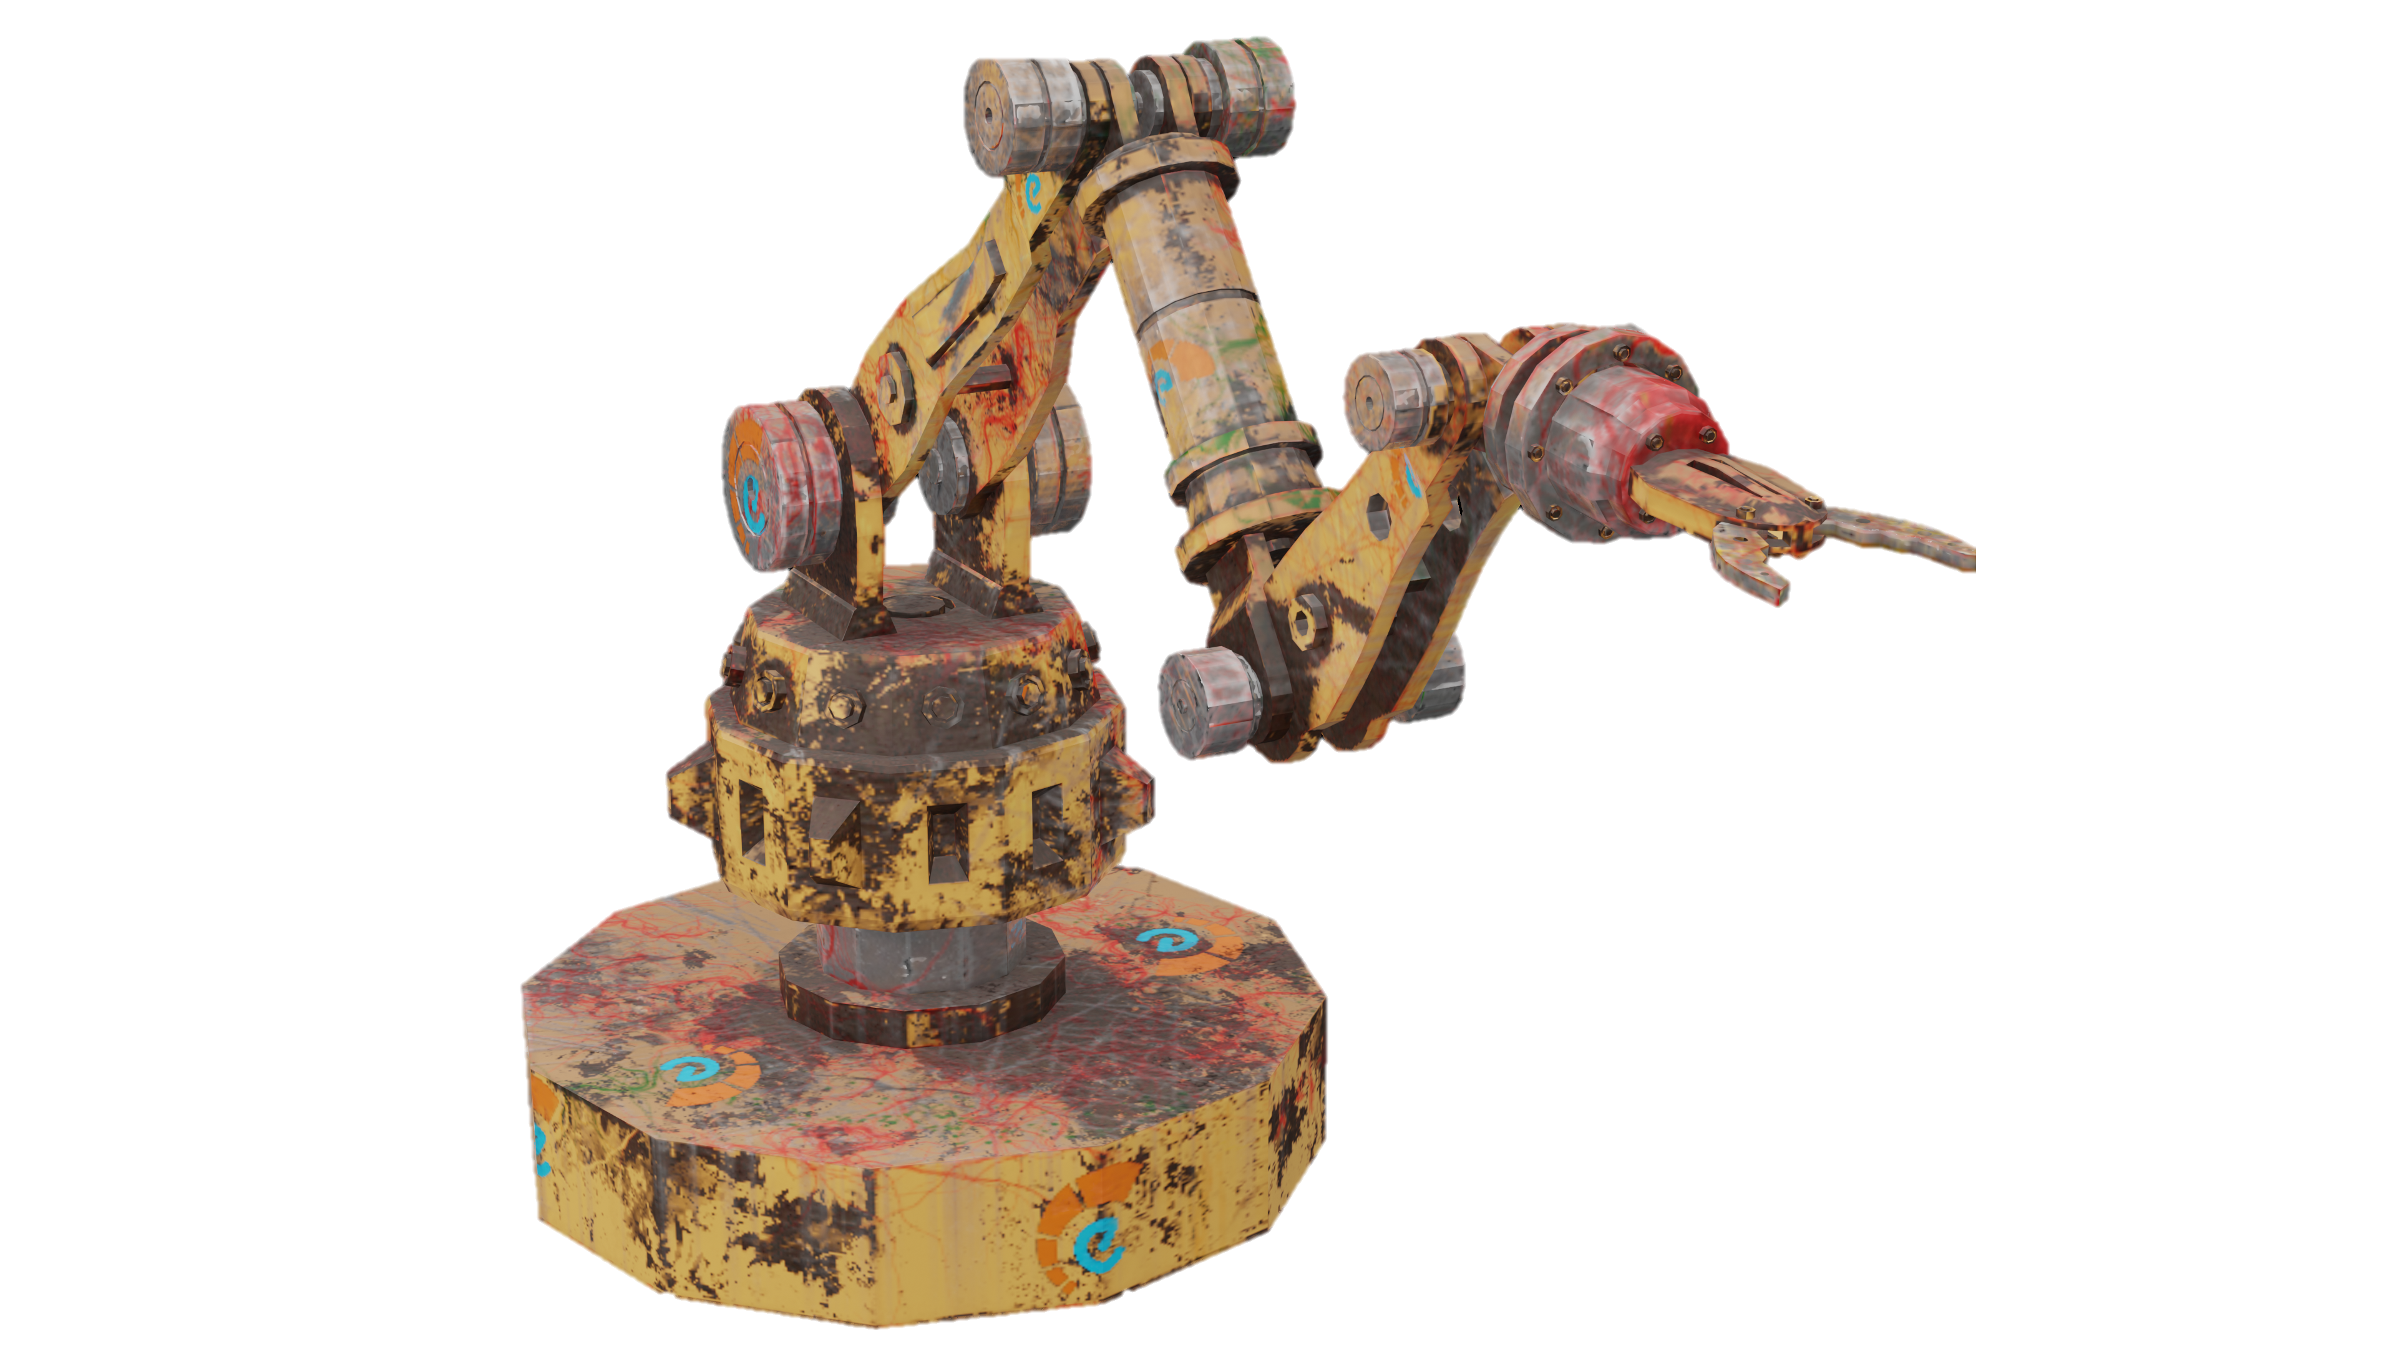
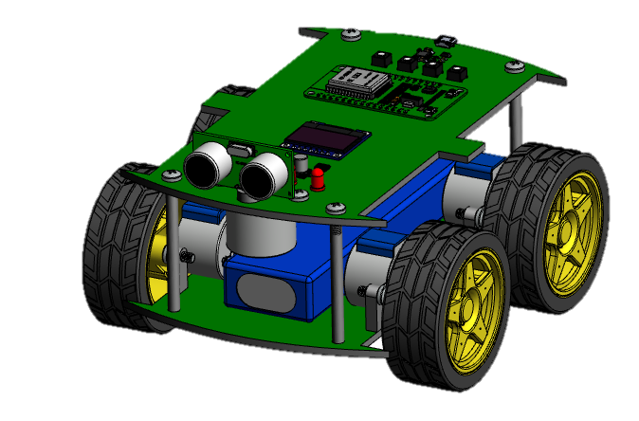

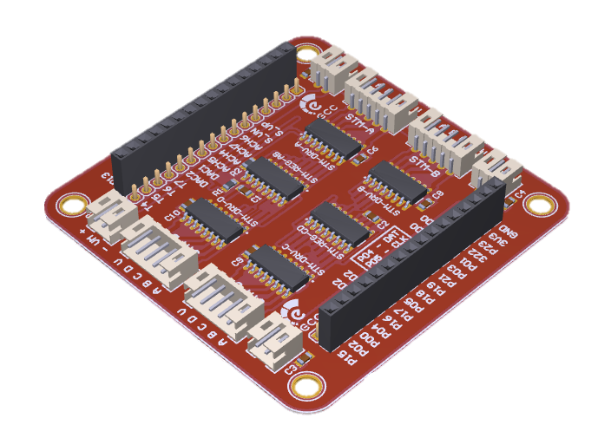
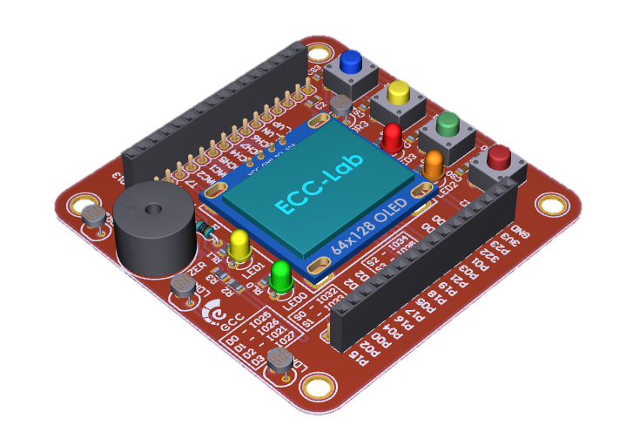
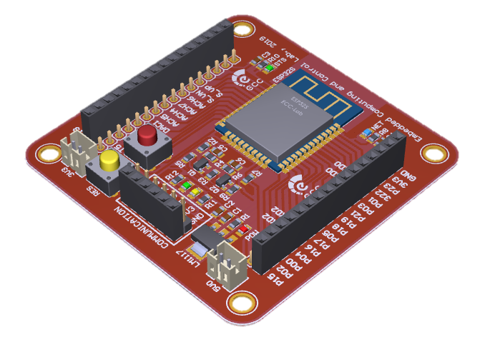
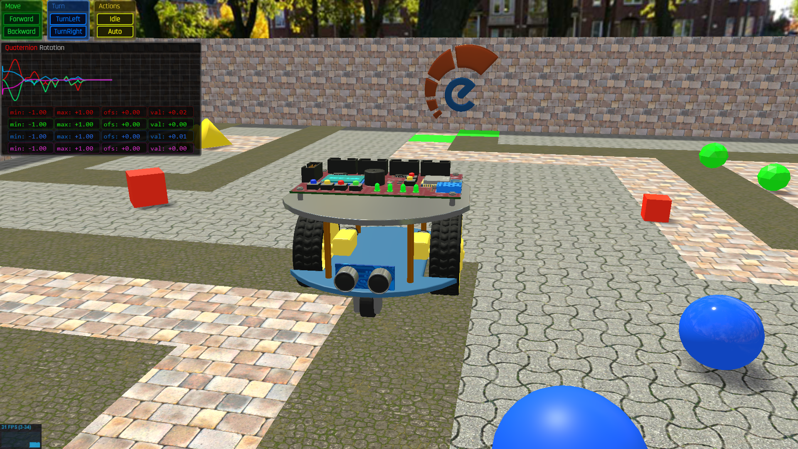

Overview
4
Laboratory Sheet
Robot
Node.js Library
Electronic Module
Robot Control
Learning Platform
Web-Based Simulator
MCU Library

Slide 4
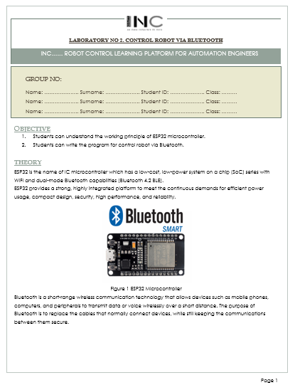
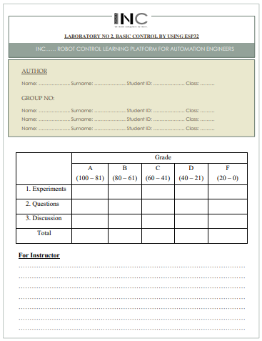
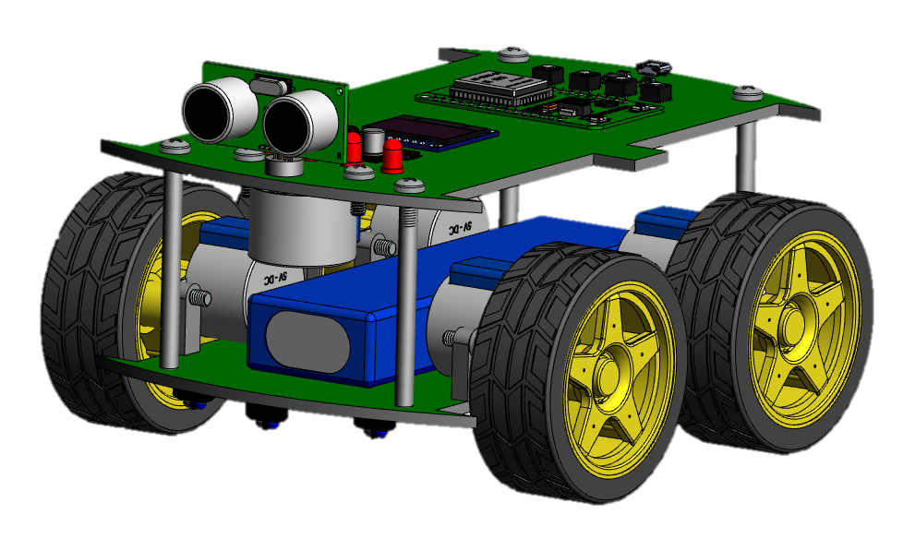
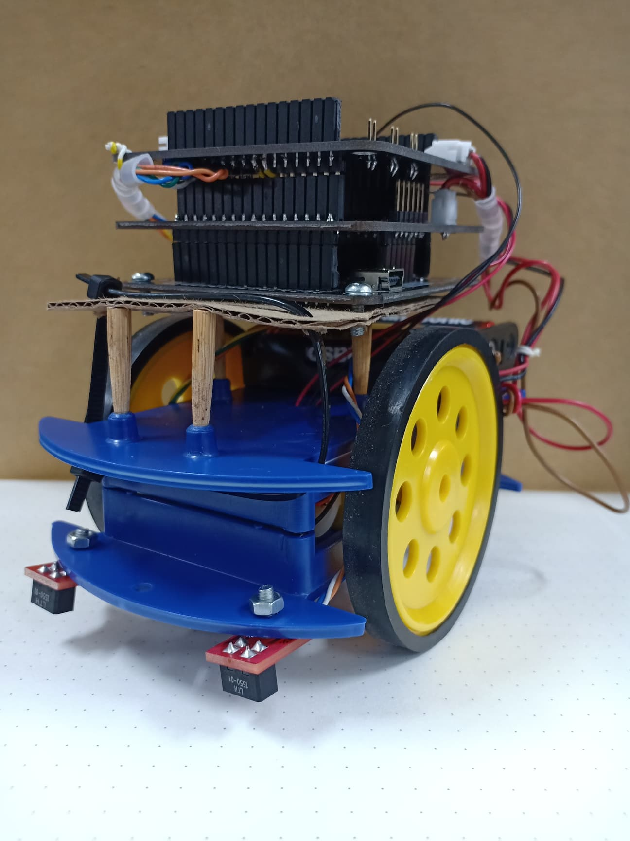
Overview
5
Library Design
(COM + MCU)
Laboratories
Robot Design
Version 1
Design first draft
Design Robot
Research + Design function
- Hardware Design
- Circuit Design
- Testing
- Basic Control
- Wi-Fi
Version 2
Form + Content
Complete Laboratory Sheets
- Simulation
- Node.js
Version 3

Slide 5
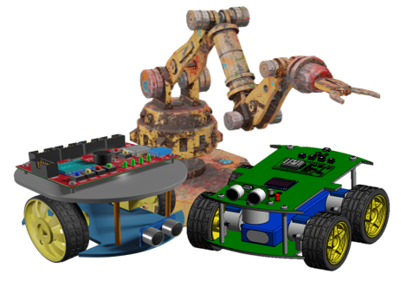
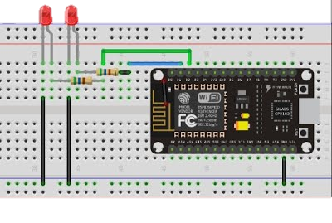

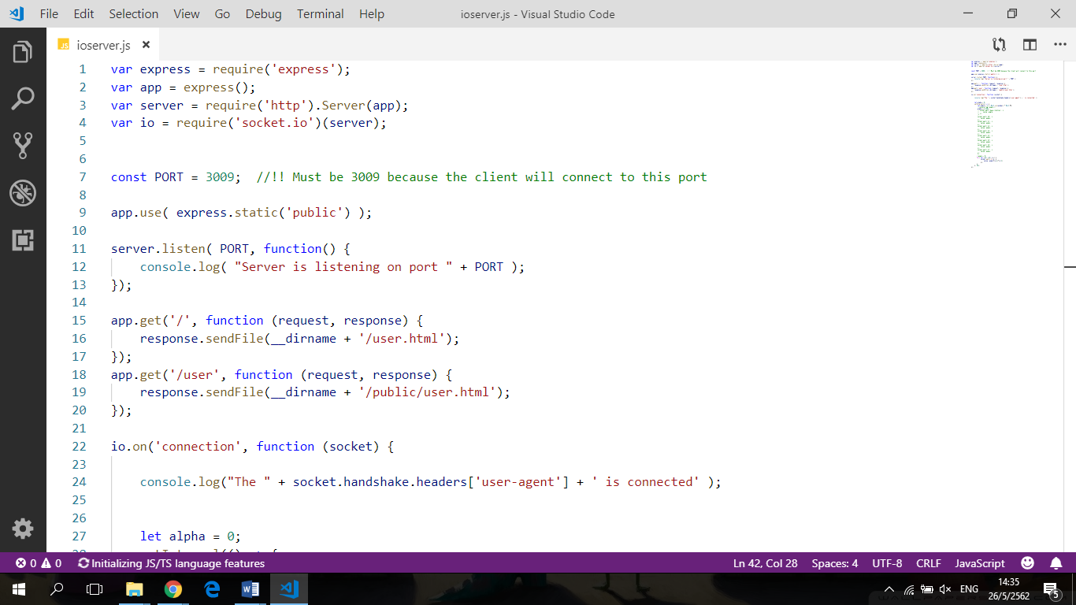

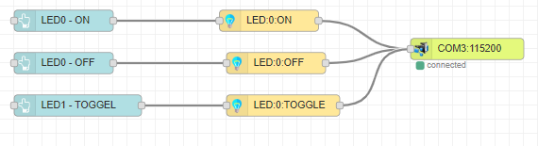
Overview
6
Basic I/O Control
Robot
Framework Feature
Text-Base Program
Graphical Program

Slide 6
7
02
Robot Microcontroller Design
Notes:
Next part is robot design

Slide 7
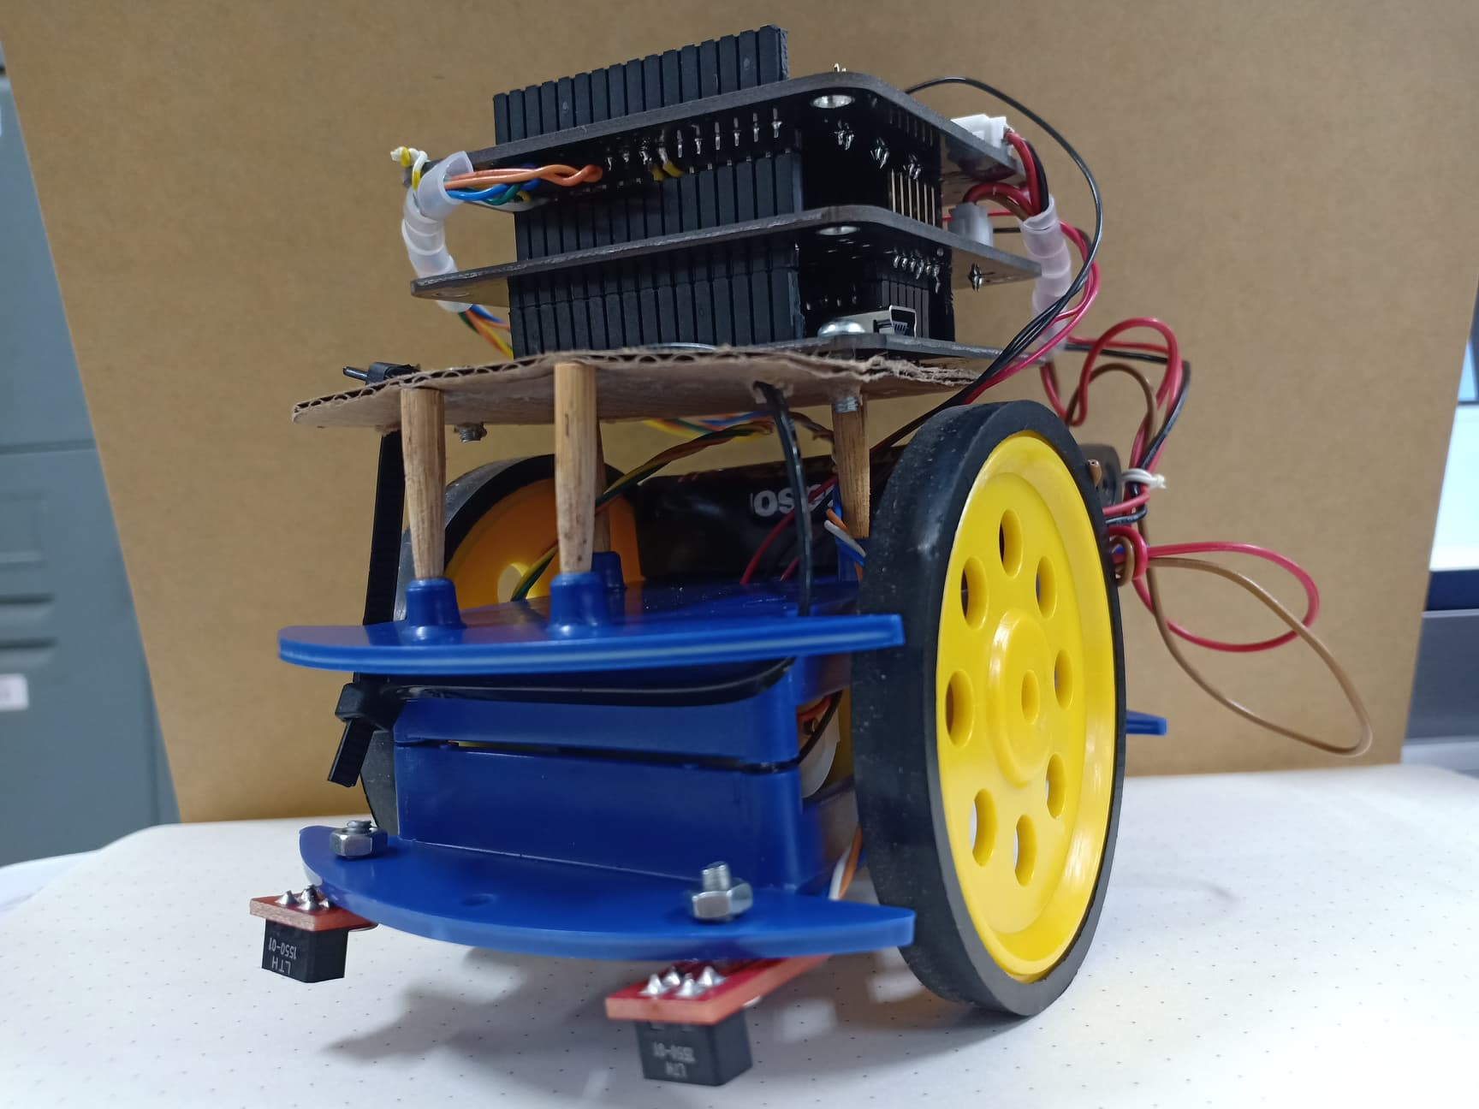
Robot Design
8
Design 1
Disadvantages Too big Fixed kind of robot Battery is too big and too much current Use a lot of motor Have specific function
Design 2
Disadvantages Not flexible to work There are still specific function
Design 3
Advantages Any robot can be use Microcontroller board will support all type of robot

Slide 8
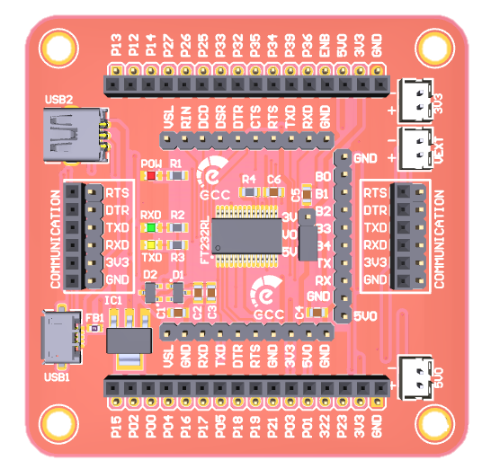
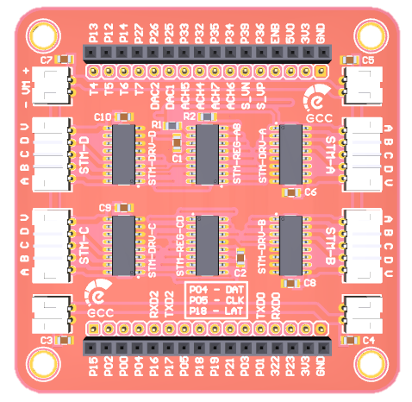
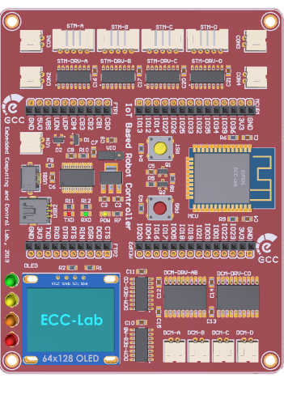
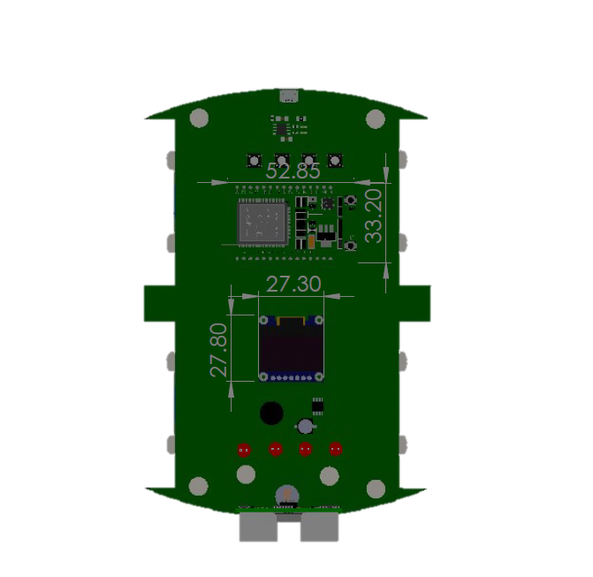
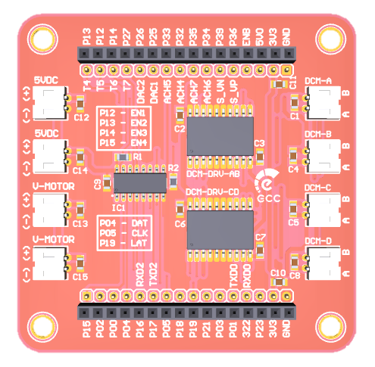
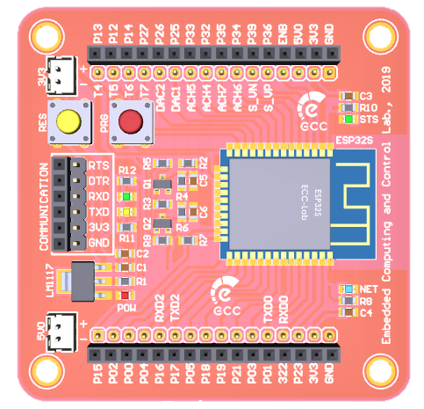
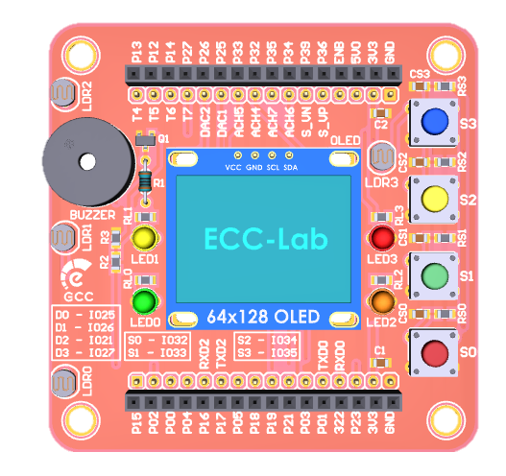

Microcontroller Design
9
FT232
ST Driver
DC Driver
PCB Design Version 1
PCB Design Version 2
MCU ESP32
Panel
PCB Design Version 3

Slide 9


MCU ESP32
10
WIFI
Bluetooth
LED indicator
(Status green, Internet connection blue)

Slide 10
Full Bridge 4 channels DC Motor Driver
11
L293D
Pulse-Width
Modulation (PWM)
Voltage range
4.5V – 36V
Current
600 mA/channel

Slide 11
4 Channels Stepper Motor Driver
12
Current
350 mA/channel
Bidirectional Stepper Motor Drive
Voltage range
3.5V – 55V

Slide 12
USB to serial adapter converter
13
Build-in
power supply
LED indicator
Full speed USB 2.0
Notes:
Build-in power supply
Full speed USB 2.0
LED indicator (ไว้แสดงผลว่ารับหรือส่งข้อมูลอยู่)

Slide 13
Front Panel (User Interface)
14
Buzzer
LCD
LED
Switch

Slide 14
15
03
Laboratory
Notes:
Next part is laboratory sheet

Slide 15
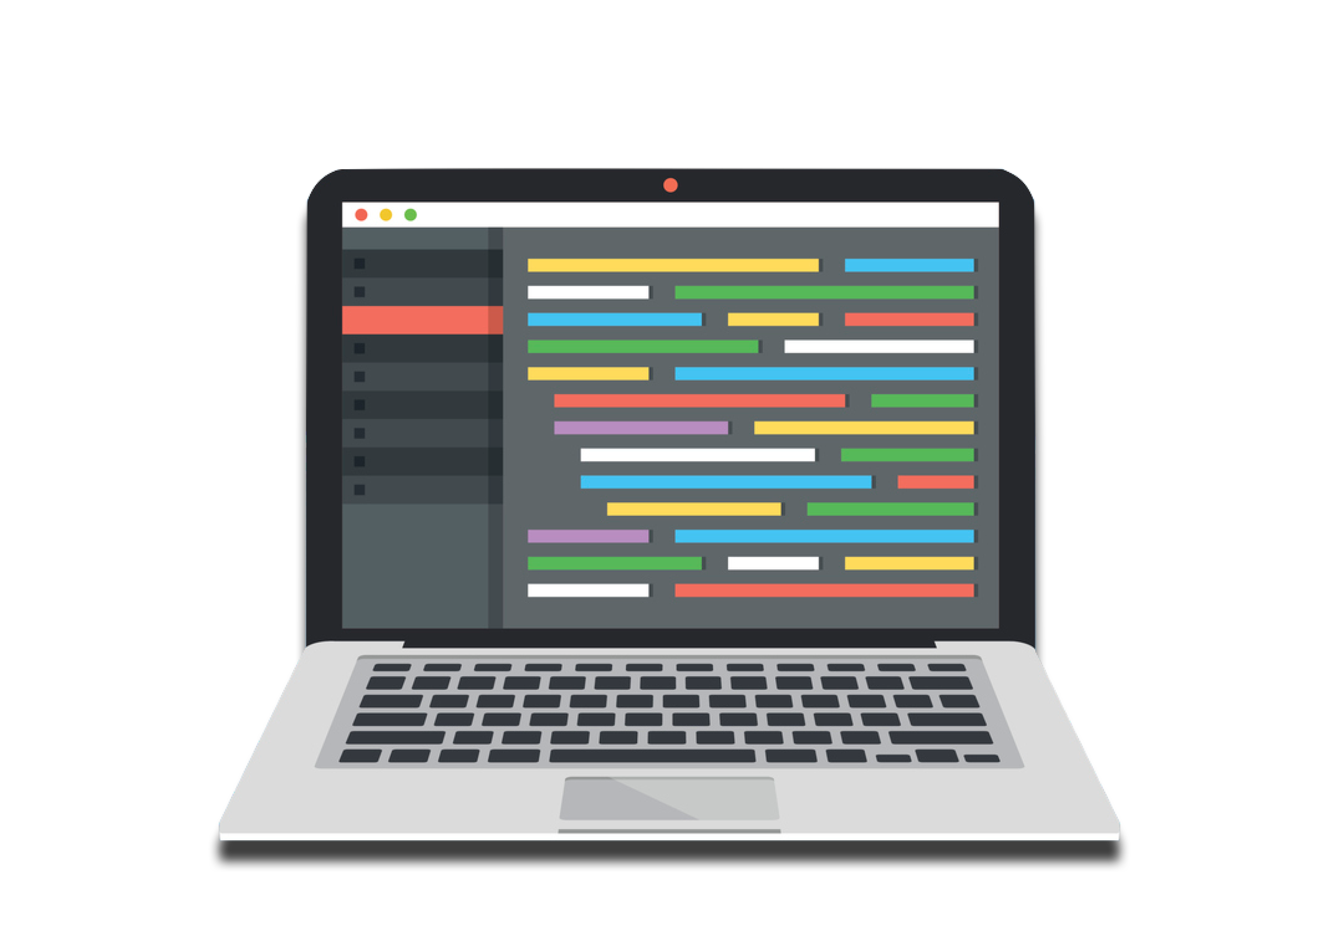

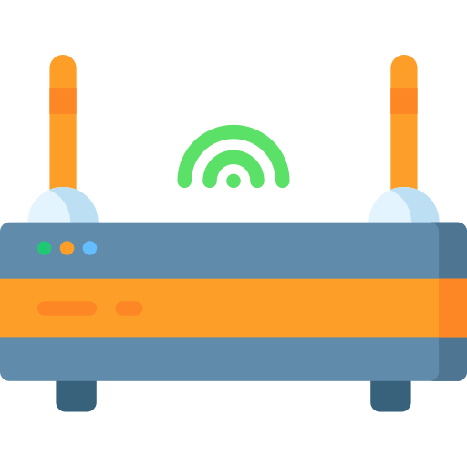

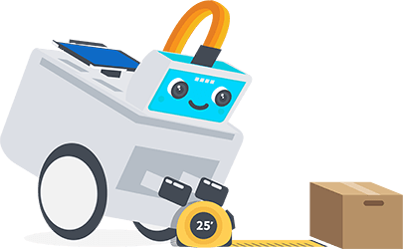

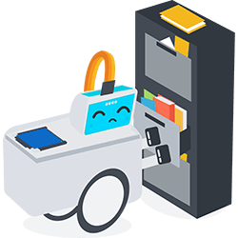
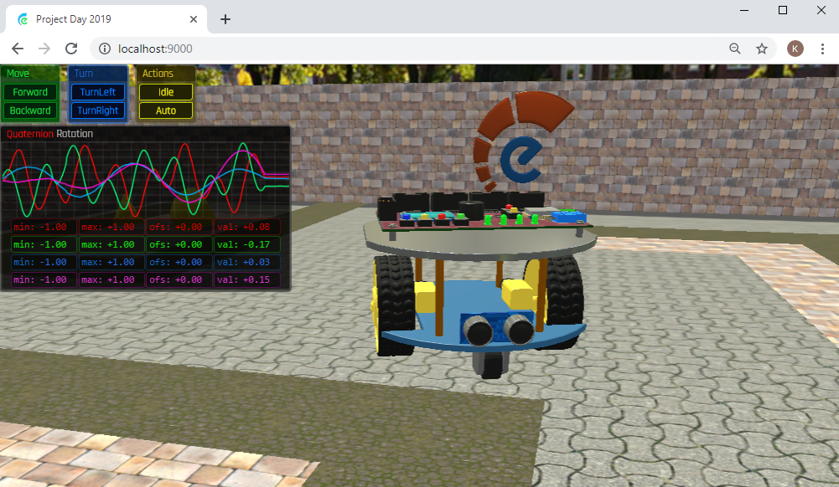


WRITE
CODE
WIFI
NETWORK
16
UDP
UDP
USB
GETINPUT.ESP32
WIFI ADAPTER
GETINPUT.ESP32
SER1 TTL
12 Laboratories
SERIAL OVER USB
(TESTING AND BENCHMARKETING
PURPOSES ONLY)
SER2 TTL
Movement
(Run, Left, Right)
Using the Ultrasonic
Distance Sensor
Line Following
Control Web-based
application and Bluetooth
Function of sensor
in Robot
Simulation

Slide 16
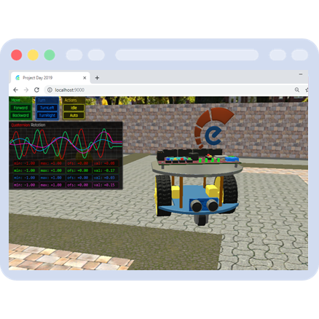
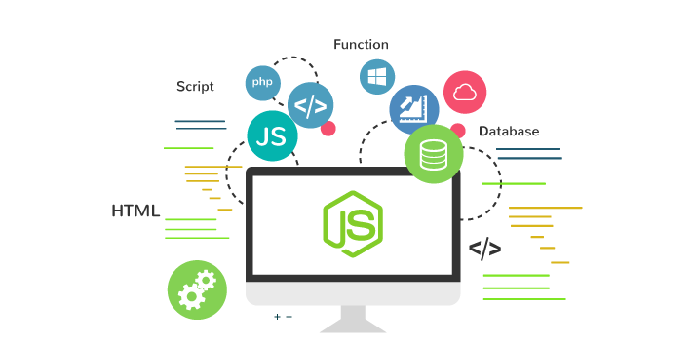

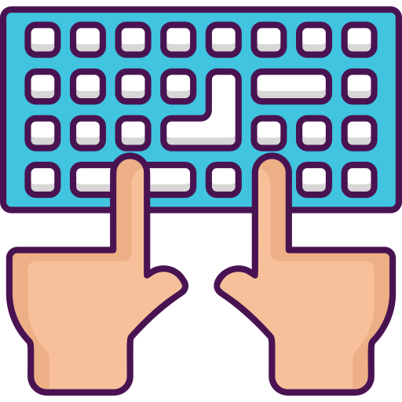
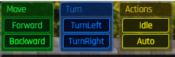

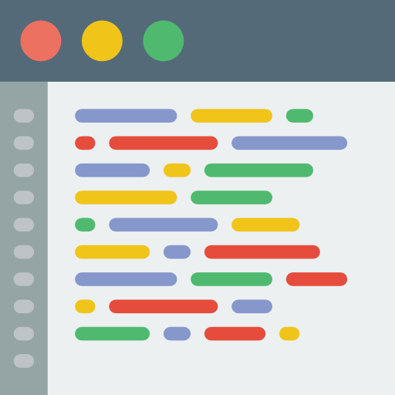
Lab Simulation
20
WRITE CODE
User
Web Browser
Node.js application through
the web browser.
Action
Keyboard
NodeJS Server
Node.js
Application
Keyboard Control
Express is a minimalistic
web framework
based on Node.js
Control Web-based
application
Movement
(Run, Left, Right)
SDK Library

